Slide 1


Jan Hofmeier, Kristina Albrecht
TINF15AI-BC
20.04.2018

Slide 2

TensorFlow Architektur
Was ist TensorFlow
Anforderungsanalyse
Einfluss-Faktoren
Architektursichten:
Szenarien
Kontextsicht
Verhaltenssicht
Struktursicht
Abbildungssicht
Bewertung der Architektur
1
+
4

Slide 3

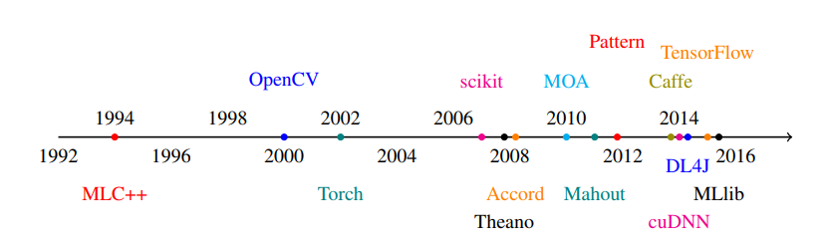
Machine Learning Frameworks
DistBelief
Quelle: https://arxiv.org/pdf/1610.01178.pdf S. 3

Slide 4

DistBelief
Vorgänger von TensorFlow
2011 von Google Brain entwickelt
Einschränkungen:
Neue Modelle erfordern Änderungen am Core
Anpassungen des Parameter-Servers für Gradientenfunktion
nur vorwärtsgerichtete Algorithmen (kein Recurrent oder Reinforcement Learning)
nur Multi-Core-CPU-Server, keine Unterstützung von GPUs oder anderen Acceleratoren
Quelle: http://download.tensorflow.org/paper/whitepaper2015.pdf

Slide 5
Anforderungen
ID | Kurzbeschreibung | Anforderung
F1 | ML Funktionalitäten | Vektor- bzw Matrizen-Operationen, Lineare Algebra, Statistik, Gradienten etc.
U1 | Prototyping | Schnelles Definieren und Testen von Modellen
U2 | Produktiver Einsatz | Möglichkeit der Entwicklung komplexer ML Anwendungen
P1 | Performance | Effiziente Nutzung verfügbarer Ressourcen
P2 | Skalierbarkeit | Umgang mit großen Datenmengen
S1 | Portabilität | Portierbar auf verschiedene Systeme
R1 | Recovery | Nach einem Abbruch wiederherstellbar
Notes:
High Level APIs
Eager Execution, which is the easiest way to use tensorflow.
Estimators, which introduces a high-level TensorFlow API that greatly simplifies ML programming.
Importing Data, which explains how to set up data pipelines to read data sets into your TensorFlow program.
Low Level APIs
Introduction, which introduces the basics of how you can use TensorFlow outside of the high Level APIs.
Tensors, which explains how to create, manipulate, and access Tensors--the fundamental object in TensorFlow.
Variables, which details how to represent shared, persistent state in your program.
Graphs and Sessions, which explains:
dataflow graphs, which are TensorFlow's representation of computations as dependencies between operations.
sessions, which are TensorFlow's mechanism for running dataflow graphs across one or more local or remote devices. If you are programming with the low-level TensorFlow API, this unit is essential. If you are programming with a high-level TensorFlow API such as Estimators or Keras, the high-level API creates and manages graphs and sessions for you, but understanding graphs and sessions can still be helpful.
Save and Restore, which explains how to save and restore variables and models.

Slide 6

Faktoren
Faktor-Index | Beschreibung | Flexibilität | Einfluss
O1 | Community und Contributions | Fest | mittel
O2 | Entwickler und interne Nutzer haben Kenntnisse in C++ und Python | Flexibel | mittel
T1 | Es werden neue Acceleratoren entwickelt (Bsp.: TPU) | Fest | stark
T2 | Die Rechenleistung einer Maschine ist begrenzt, weshalb horizontal skaliert werden muss | Fest | stark
T3 | Verschiedene Betriebssysteme (Linux , Mac OS, Windows etc.) | Fest | stark
P1 | Neue Bibliotheken können integriert werden | Flexibel | gering
P2 | Modelle können sehr komplex werden und viele Daten involvieren | Fest | stark
Notes:
High Level APIs
Eager Execution, which is the easiest way to use tensorflow.
Estimators, which introduces a high-level TensorFlow API that greatly simplifies ML programming.
Importing Data, which explains how to set up data pipelines to read data sets into your TensorFlow program.
Low Level APIs
Introduction, which introduces the basics of how you can use TensorFlow outside of the high Level APIs.
Tensors, which explains how to create, manipulate, and access Tensors--the fundamental object in TensorFlow.
Variables, which details how to represent shared, persistent state in your program.
Graphs and Sessions, which explains:
dataflow graphs, which are TensorFlow's representation of computations as dependencies between operations.
sessions, which are TensorFlow's mechanism for running dataflow graphs across one or more local or remote devices. If you are programming with the low-level TensorFlow API, this unit is essential. If you are programming with a high-level TensorFlow API such as Estimators or Keras, the high-level API creates and manages graphs and sessions for you, but understanding graphs and sessions can still be helpful.
Save and Restore, which explains how to save and restore variables and models.

Slide 7

Szenarien
Experimentieren, neue Modelle erforschen
Prototyp erstellen
ML-Anwendungen entwickeln
Notes:
High Level APIs
Eager Execution, which is the easiest way to use tensorflow.
Estimators, which introduces a high-level TensorFlow API that greatly simplifies ML programming.
Importing Data, which explains how to set up data pipelines to read data sets into your TensorFlow program.
Low Level APIs
Introduction, which introduces the basics of how you can use TensorFlow outside of the high Level APIs.
Tensors, which explains how to create, manipulate, and access Tensors--the fundamental object in TensorFlow.
Variables, which details how to represent shared, persistent state in your program.
Graphs and Sessions, which explains:
dataflow graphs, which are TensorFlow's representation of computations as dependencies between operations.
sessions, which are TensorFlow's mechanism for running dataflow graphs across one or more local or remote devices. If you are programming with the low-level TensorFlow API, this unit is essential. If you are programming with a high-level TensorFlow API such as Estimators or Keras, the high-level API creates and manages graphs and sessions for you, but understanding graphs and sessions can still be helpful.
Save and Restore, which explains how to save and restore variables and models.

Slide 8
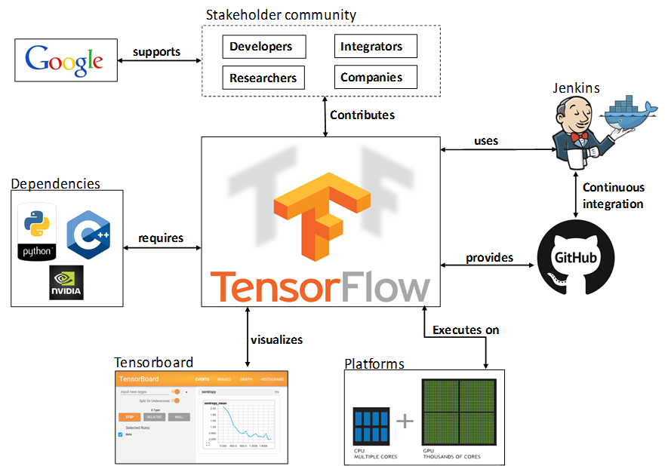

Kontextsicht
Quelle: https://delftswa.gitbooks.io/desosa2016/content/tensorflow/chapter.html

Slide 9
Verhaltenssicht
Graphs
Gerichtet
Nodes
Operators --> MM, add...
Placeholder --> Einagbewerte
Variables --> Weights
Quelle: https://www.tensorflow.org/programmers_guide/graphs

Slide 10
Code Hierarchie
Tensorflow
cc
core
contrib
python
java
go
…
models
stream_executor
tools
user_ops
Quelle: https://github.com/tensorflow/tensorflow/tree/master/tensorflow

Slide 11
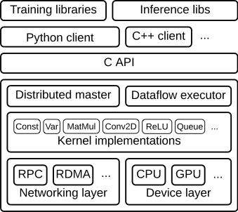

Struktursicht
Quelle: https://www.tensorflow.org/extend/architecture

Slide 12
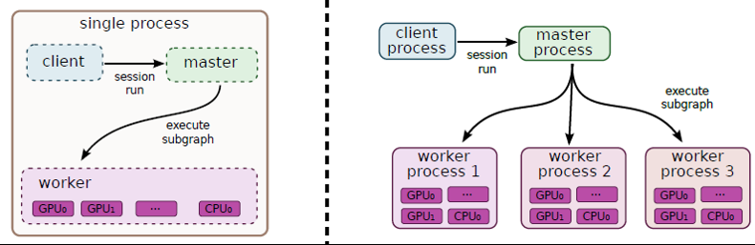
Abbildungssicht
Quelle: http://download.tensorflow.org/paper/whitepaper2015.pdf

Slide 13
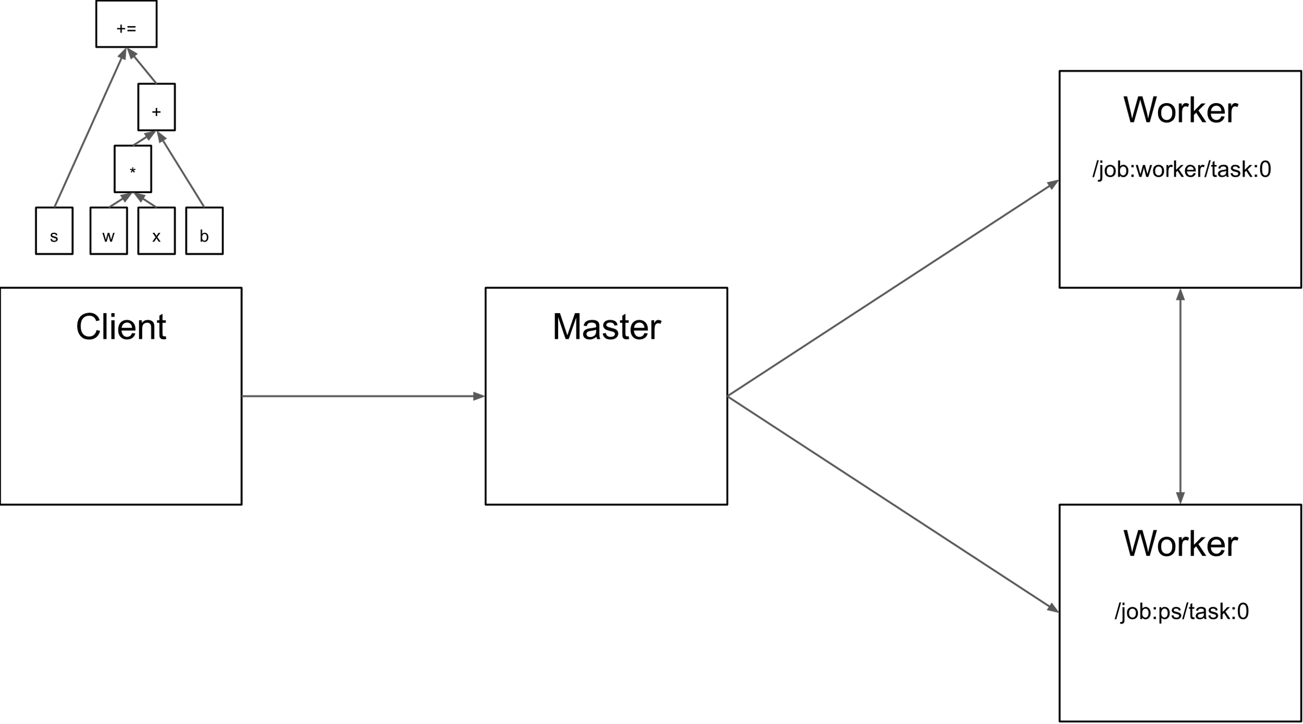
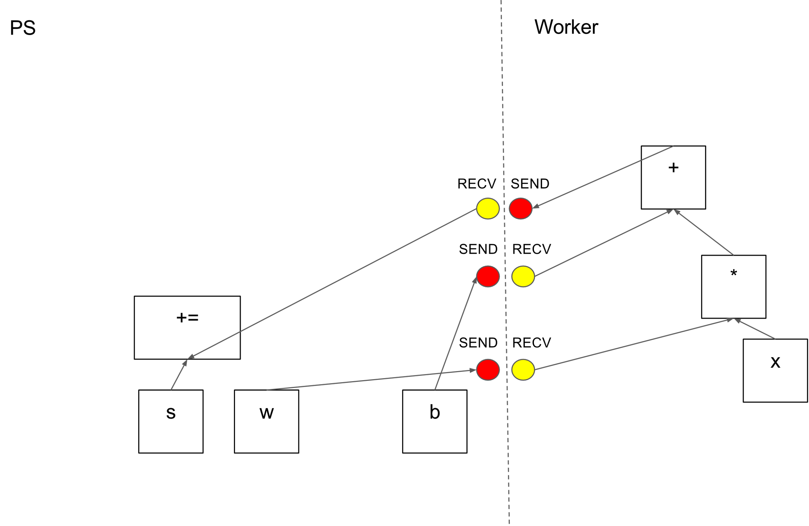
Abbildungssicht
Quelle: http://download.tensorflow.org/paper/whitepaper2015.pdf

Slide 14





Fazit
ID | Kurzbeschreibung | Umsetzung
F1 | ML Funktionalitäten | Externe Bibliotheken, Kernel Implementierungen
U1 | Protoyping | High Level APIs
U2 | Produktiver Einsatz | Low Level APIs
P1 | Performance | C++ Client, Kernel Implementierungen
P2 | Skalierbarkeit | Verteilbarkeit
S1 | Portabilität | Device Layer
R1 | Recovery | Persistierung
Notes:
High Level APIs
Eager Execution, which is the easiest way to use tensorflow.
Estimators, which introduces a high-level TensorFlow API that greatly simplifies ML programming.
Importing Data, which explains how to set up data pipelines to read data sets into your TensorFlow program.
Low Level APIs
Introduction, which introduces the basics of how you can use TensorFlow outside of the high Level APIs.
Tensors, which explains how to create, manipulate, and access Tensors--the fundamental object in TensorFlow.
Variables, which details how to represent shared, persistent state in your program.
Graphs and Sessions, which explains:
dataflow graphs, which are TensorFlow's representation of computations as dependencies between operations.
sessions, which are TensorFlow's mechanism for running dataflow graphs across one or more local or remote devices. If you are programming with the low-level TensorFlow API, this unit is essential. If you are programming with a high-level TensorFlow API such as Estimators or Keras, the high-level API creates and manages graphs and sessions for you, but understanding graphs and sessions can still be helpful.
Save and Restore, which explains how to save and restore variables and models.

